Slide 1
IS 120
JavaScript Intro to APIs

Slide 2
Announcements
HW 11 will be posted after class

Slide 3
JSON Review
{
“name": "Sarah",
"age": 28,
"isStudent": true
}

Slide 4
JSON Rules
Top level must be an object or an array
  {} or []
JSON only uses double quotes “ ”
JSON doesn’t allow comments

Slide 5
JavaScript JSON methods
JSON.stringify() <- turns a JS object into JSON
JSON.parse() <- turns JSON into a JS object

Slide 6
Todo List Review
Render
array
HTML Input
Add item
JavaScript
Array
DOM Elements

Slide 7
Todo List Review
Render
array
HTML Input
Add item
JavaScript
Array
DOM Elements
Update
Local Storage

Slide 8
Todo List Review
Render
array
JavaScript
Array
DOM Elements
Update
Local Storage
On Load
If

Slide 9
Todo List Review
Where do we need JSON stringify and parse?

Slide 10
Todo List Review
Where do we need JSON stringify and parse?
Why should we use an array to store our to do items in local storage?

Slide 11
APIs
Application Programming Interface
A way for programs to talk to each other
Most use a URL format
https://api.example.com/users/42

Slide 12
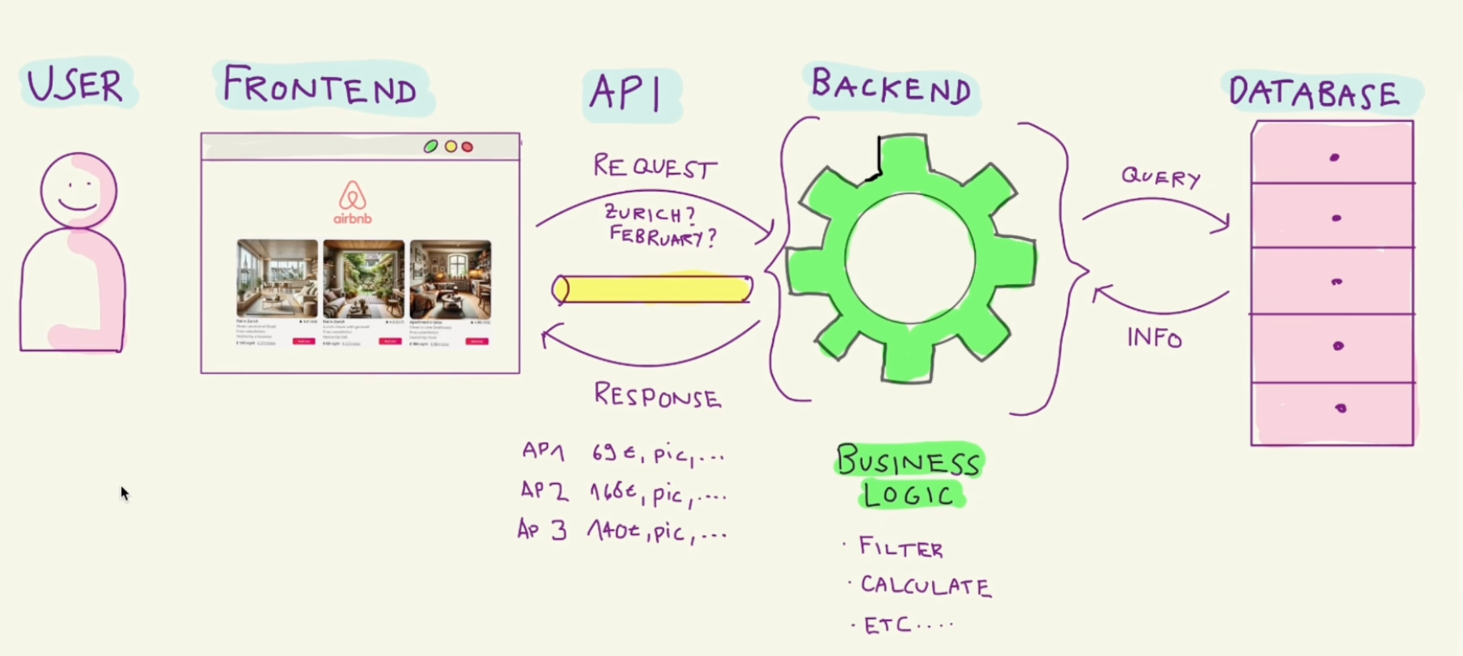
APIs

Slide 13
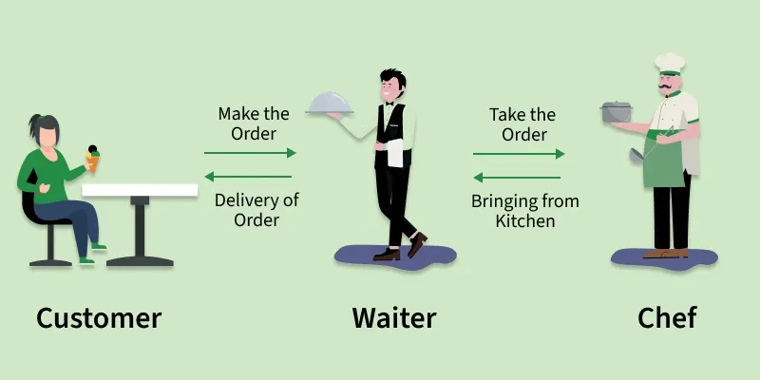
APIs

Slide 14
APIs
In this class, we will focus on how to use APIs and integrate them into a frontend, but we won’t actually build them
That’s the job of a backend developer

Slide 15
API Types
Public: Available to everyone, a way to give people public access to information or operations
  Great way to use data or functionality someone else built without reinventing the wheel
  Examples: Weather, Google Maps, OpenAI, Spotify, etc.
Private : An API used internally by a business. Something you build for yourself only for you to use.

Slide 16
API Keys
Some public APIs require a key, some don’t
API keys let APIs know who is making the request
This can be used to limit requests or charge for usage
OpenAI, Google Maps, Stripe
For now, we will stick to APIs without keys

Slide 17
How to Use an API?
Exact use differs by API, that’s why it’s important to read the documentation!
Some important terms to know
Base -> https://api.example.com
Endpoint -> /weather/today
Query Parameters -> /weather?city=Provo&units=imperial

Slide 18
How to Use an API?
API Endpoint
What you’re asking from the API
Example: What’s the weather today?
https://api.example.com/weather/today

Slide 19
How to Use an API?
API Query Parameters
How you want the specific data
Starts with ? separated by &
Example: What’s the weather today in Provo? Use imperial units
https://api.example.com/weather?city=Provo&units=imperial

Slide 20
How to Use an API?
Not all APIs follow the same format, that’s why it’s important to look at documentation to understand how it is meant to be used

Slide 21
API Pair Programming
https://bored-api.appbrewery.com/
Paste the API calls as your browser URL. Don’t need JavaScript
Get a random activity
Get all activities I can do with 3 people
Get all activities I can do that are cooking related
Get activity number 4179309

Slide 22
APIs with JavaScript

Slide 23
HW 11
Complete instructions will be posted after class

Slide 24
Before Next Class
Create a supabase account!
https://supabase.com/

